Slide 1
Progress Summary
Mar 31st 2023
Youfu Qian

Slide 2
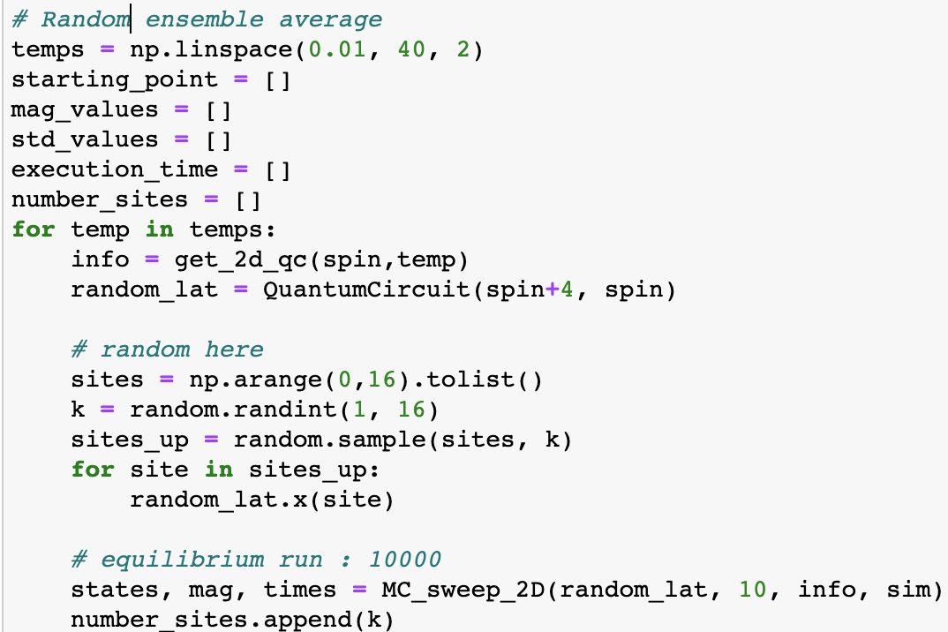
Simulators:
Statevector_simulator (ideal, deem the system at a big matrix and calculate with all the info)
Aer_simulator (real, measure and sample the qubit system for each iteration)
Initial Conditions:
FM: all spin down
Random: randomly assign spin ups

Slide 3
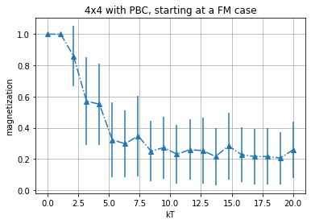
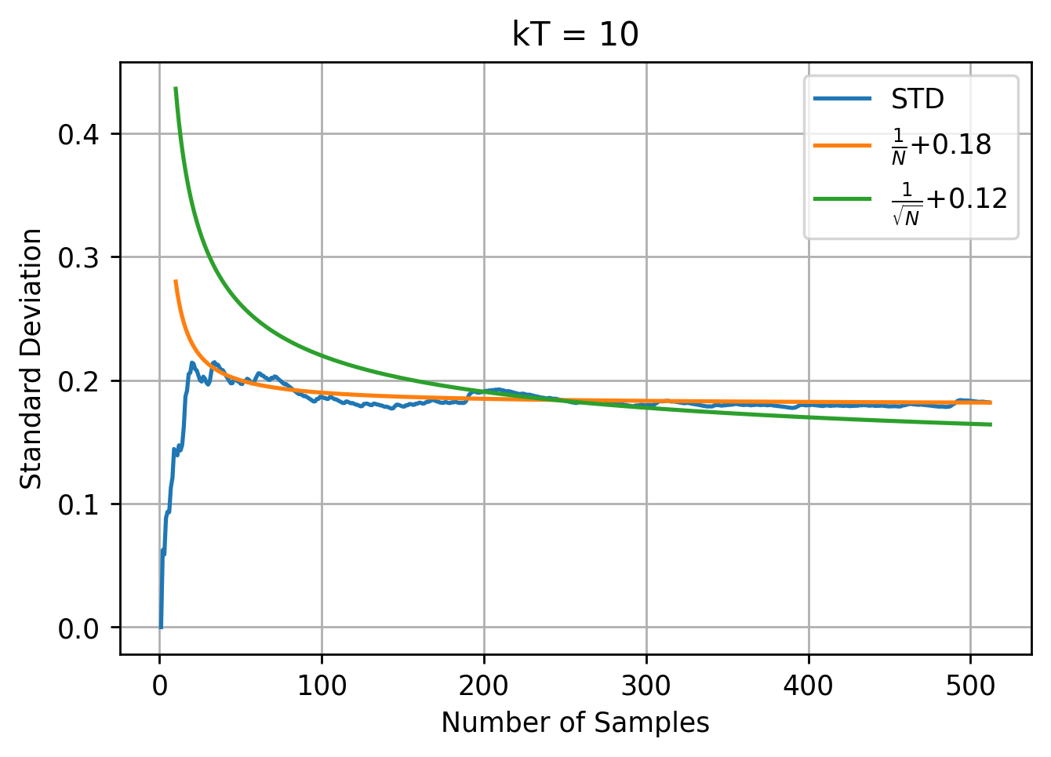
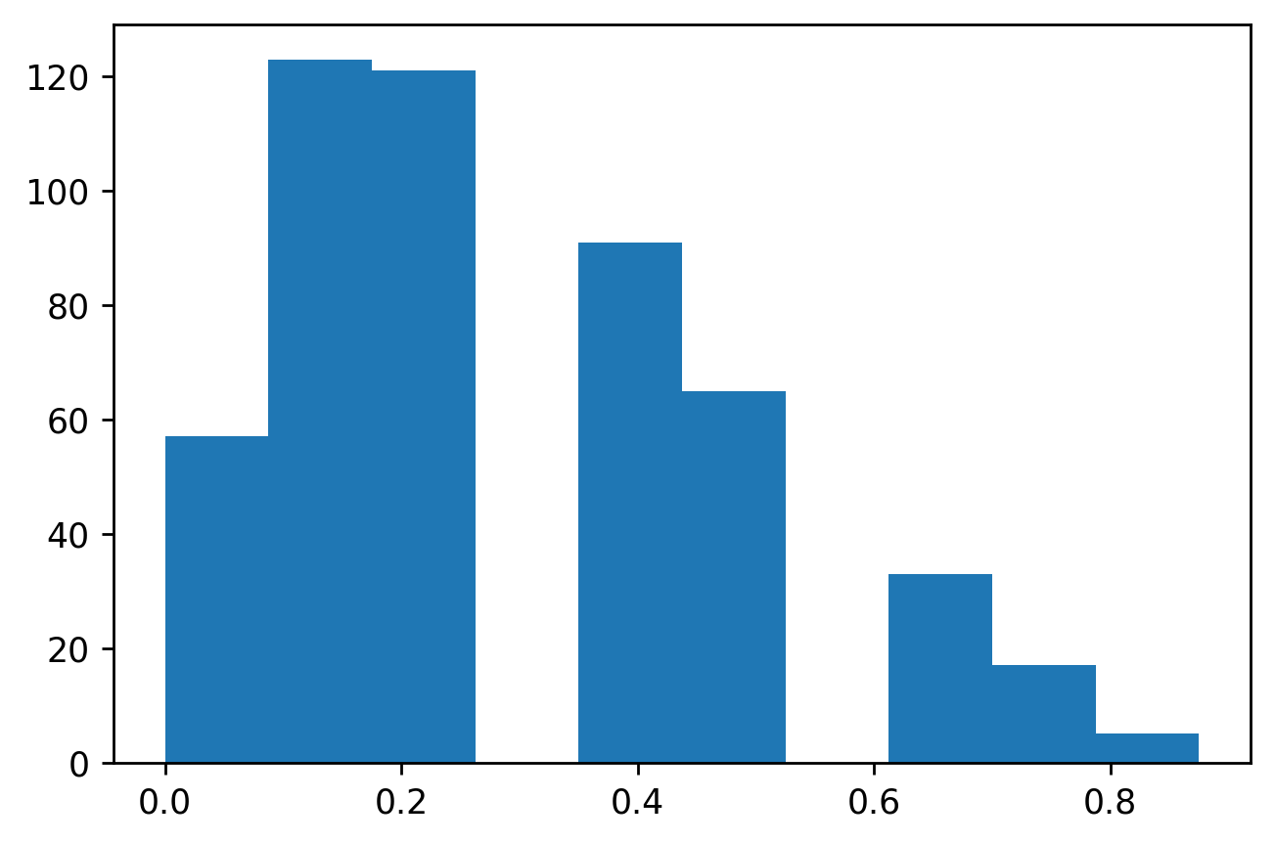
Statevector, FM starting point:
512 Iter
Magnetization (kT=10)

Slide 4
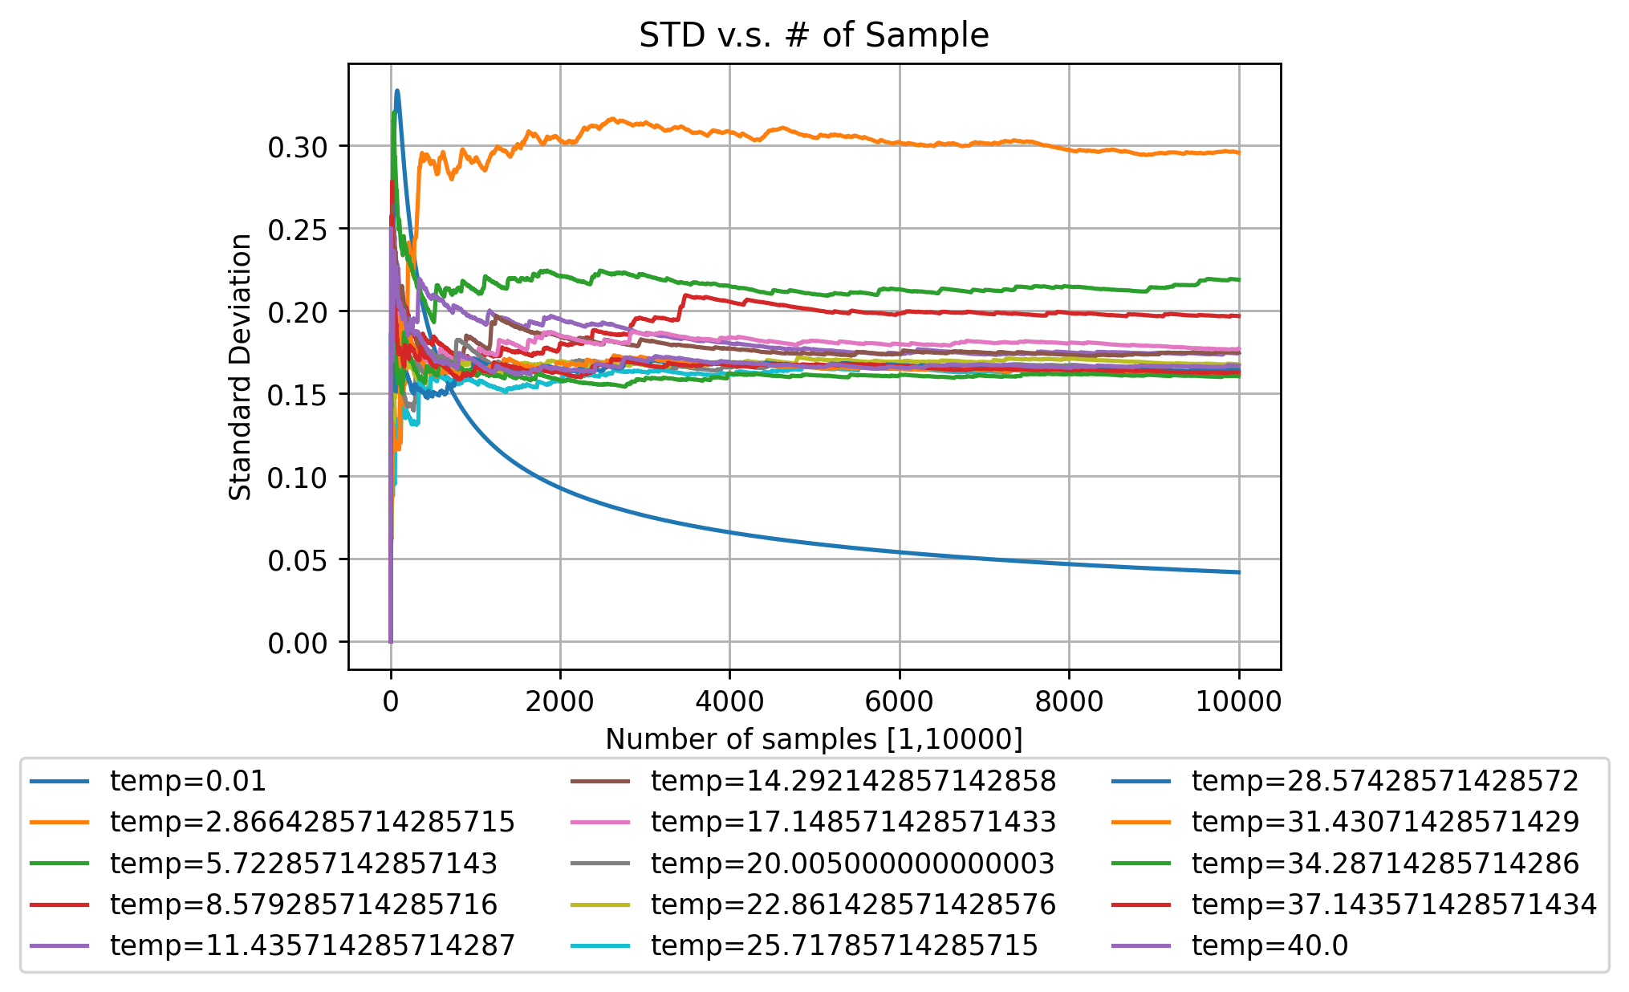
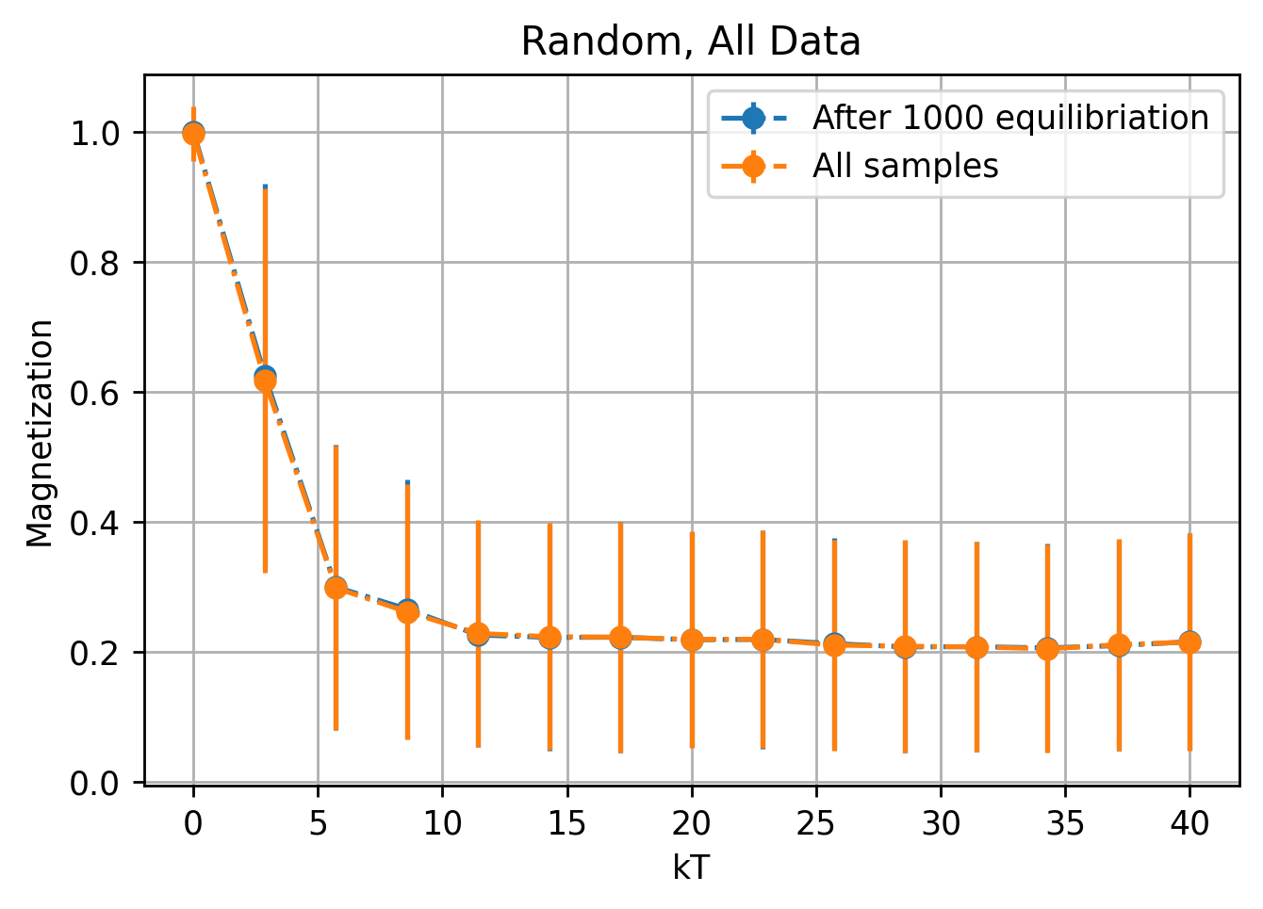
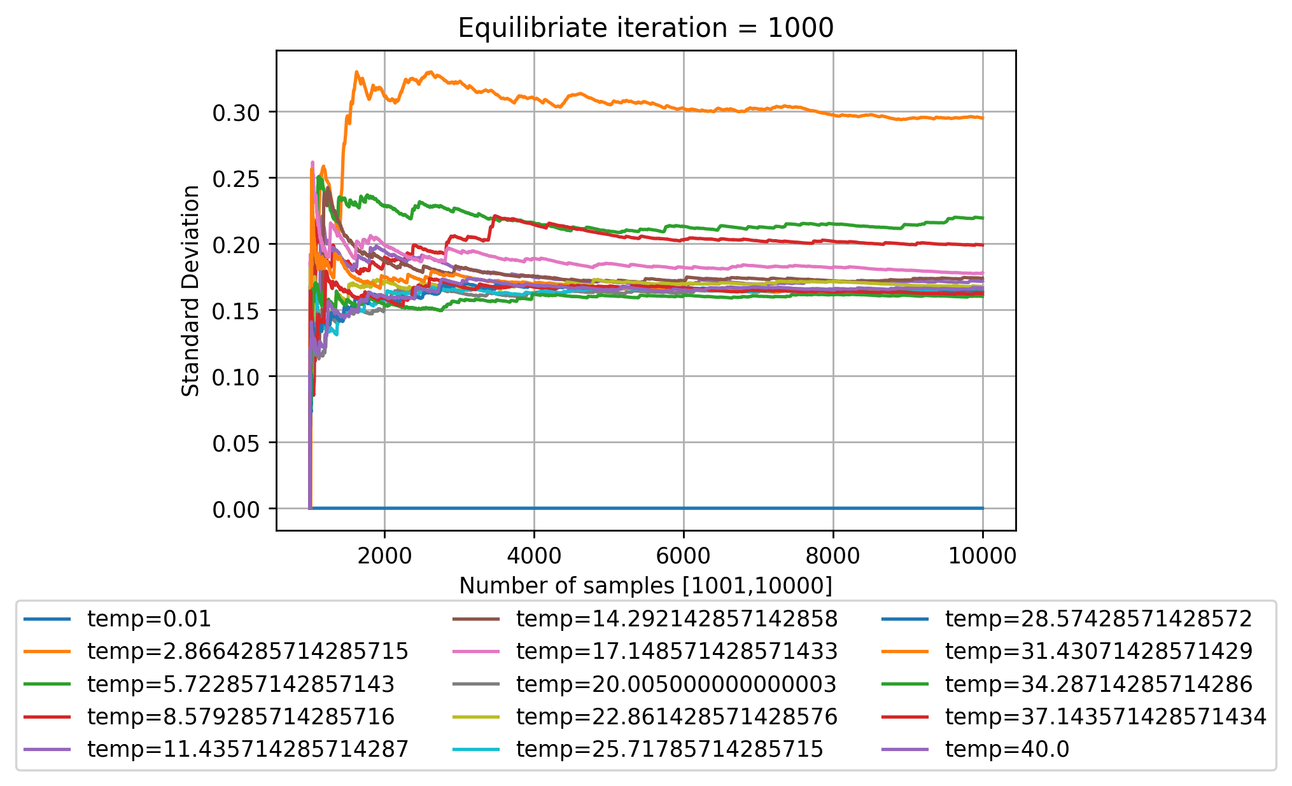
Statevector: Random starting point
10,000 Iter from now on

Slide 5
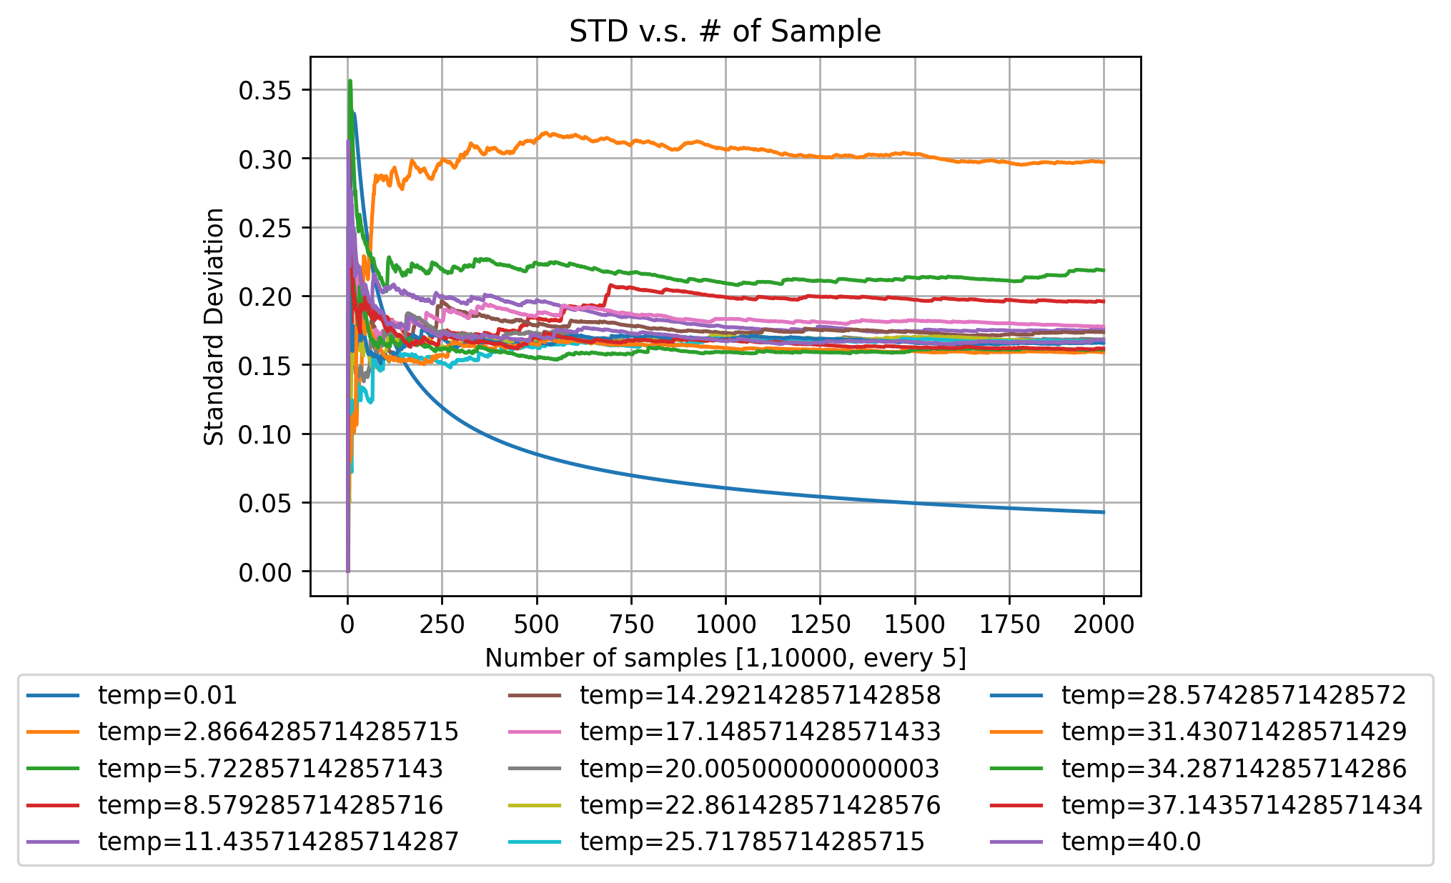
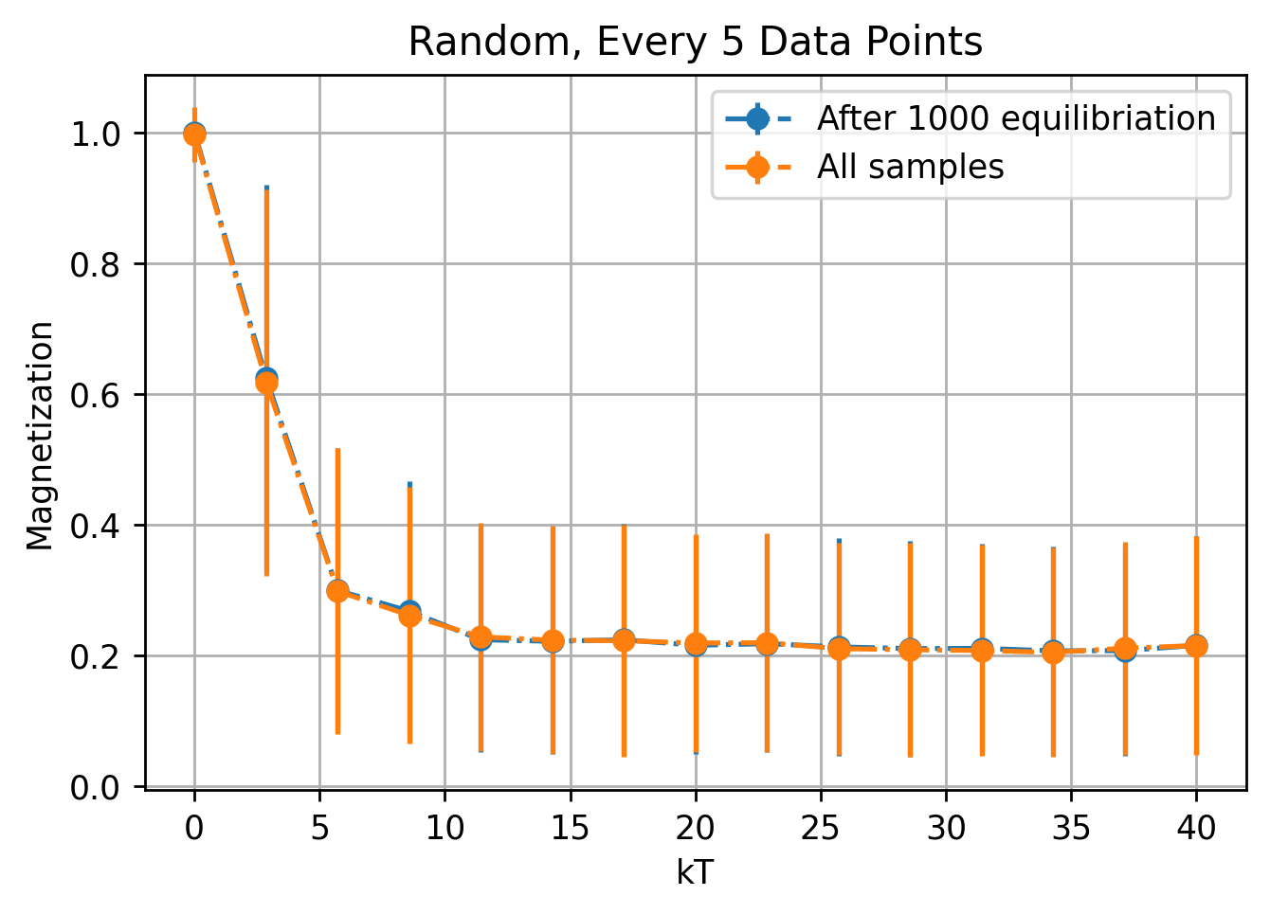
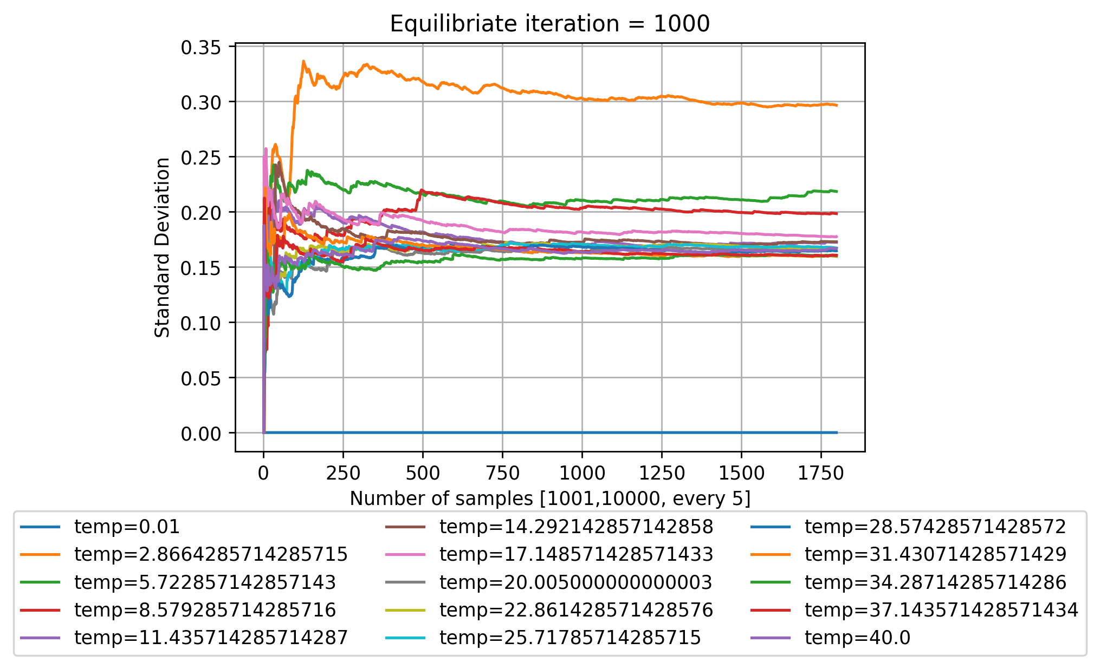
Statevector: Random starting point (Relax for 5 iter’s)

Slide 6
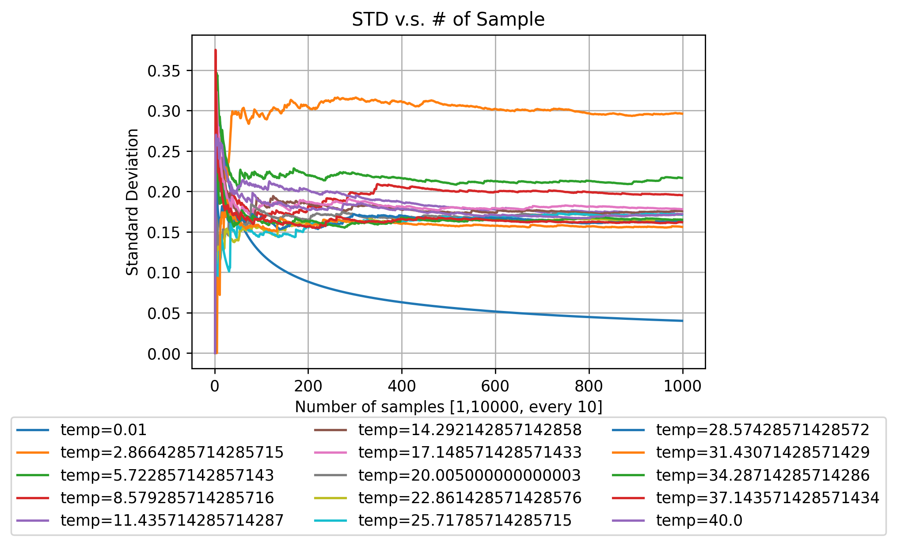

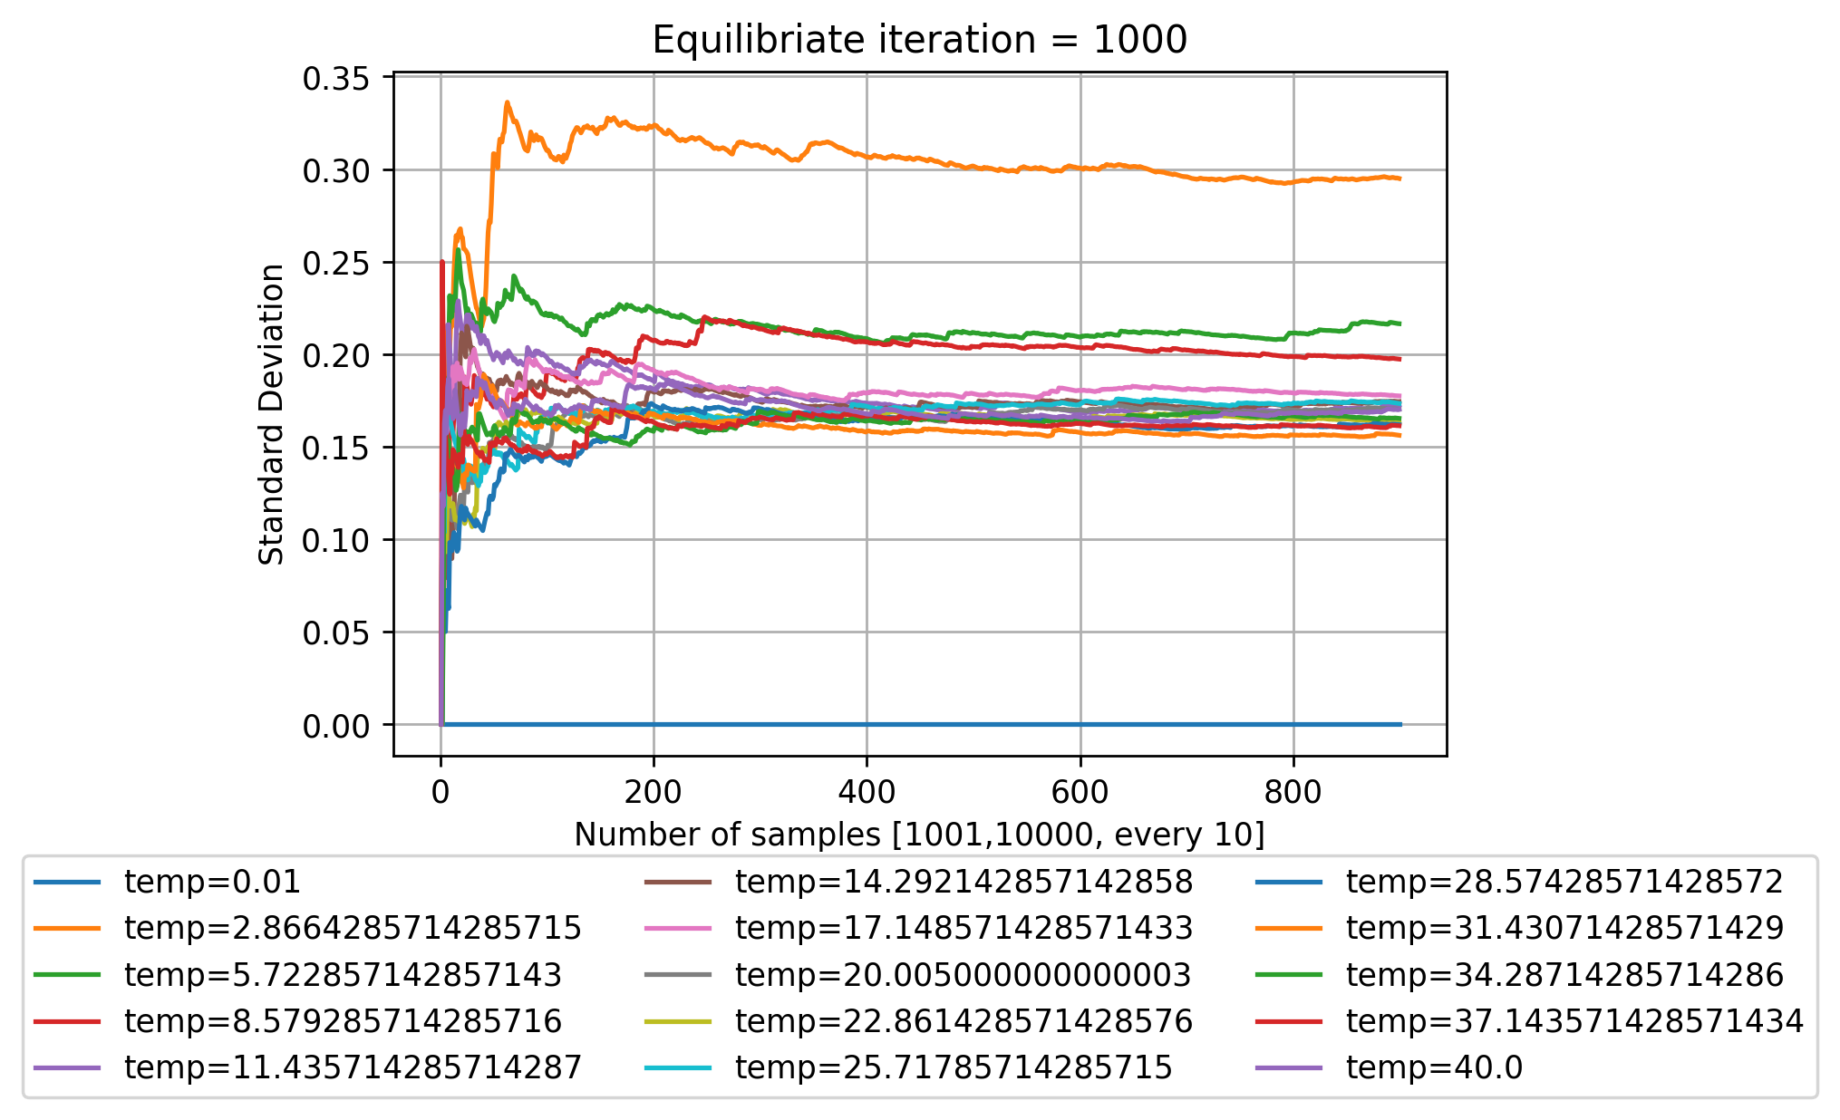
Statevector: Random starting point (Relax for 10 iter’s)

Slide 7
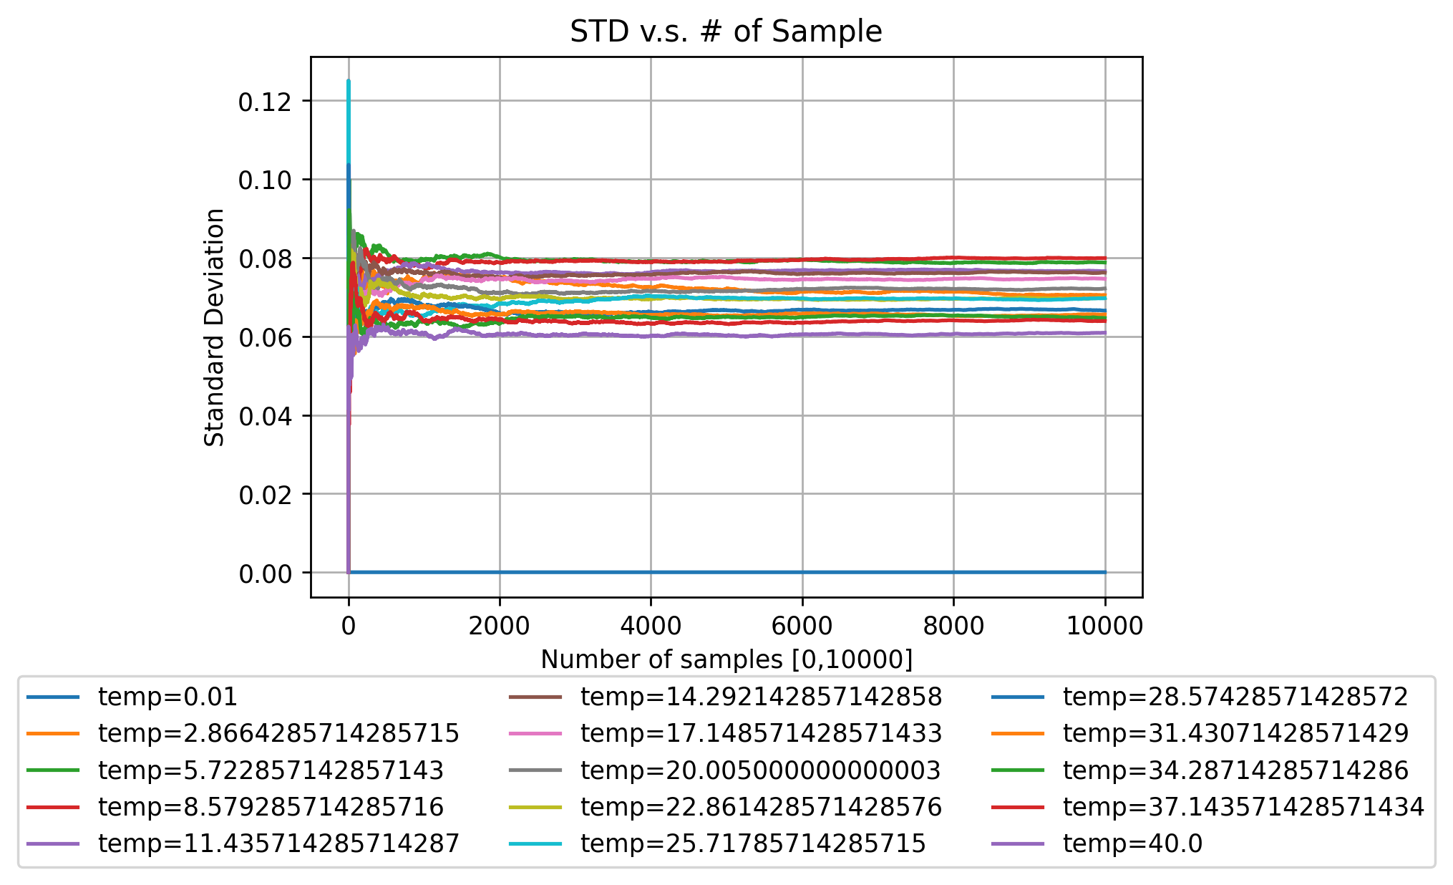
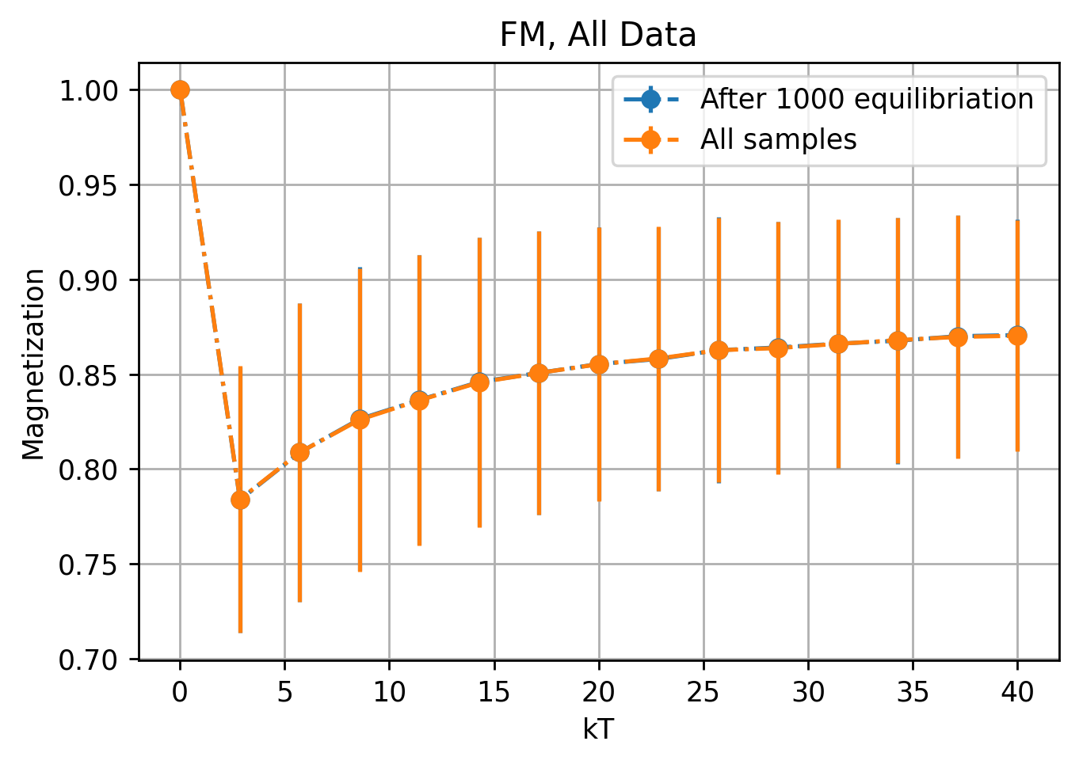
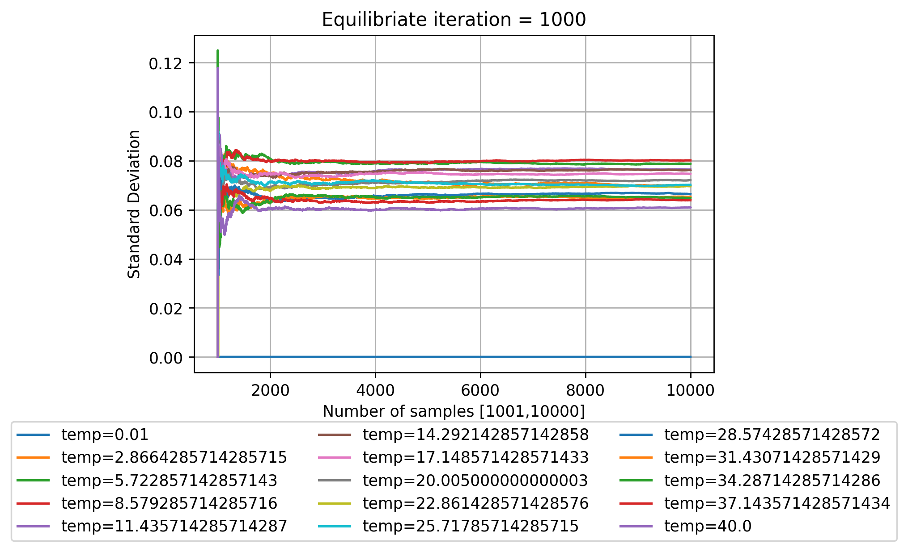
Aer_simulator: FM starting point (weird thing starts happening)

Slide 8
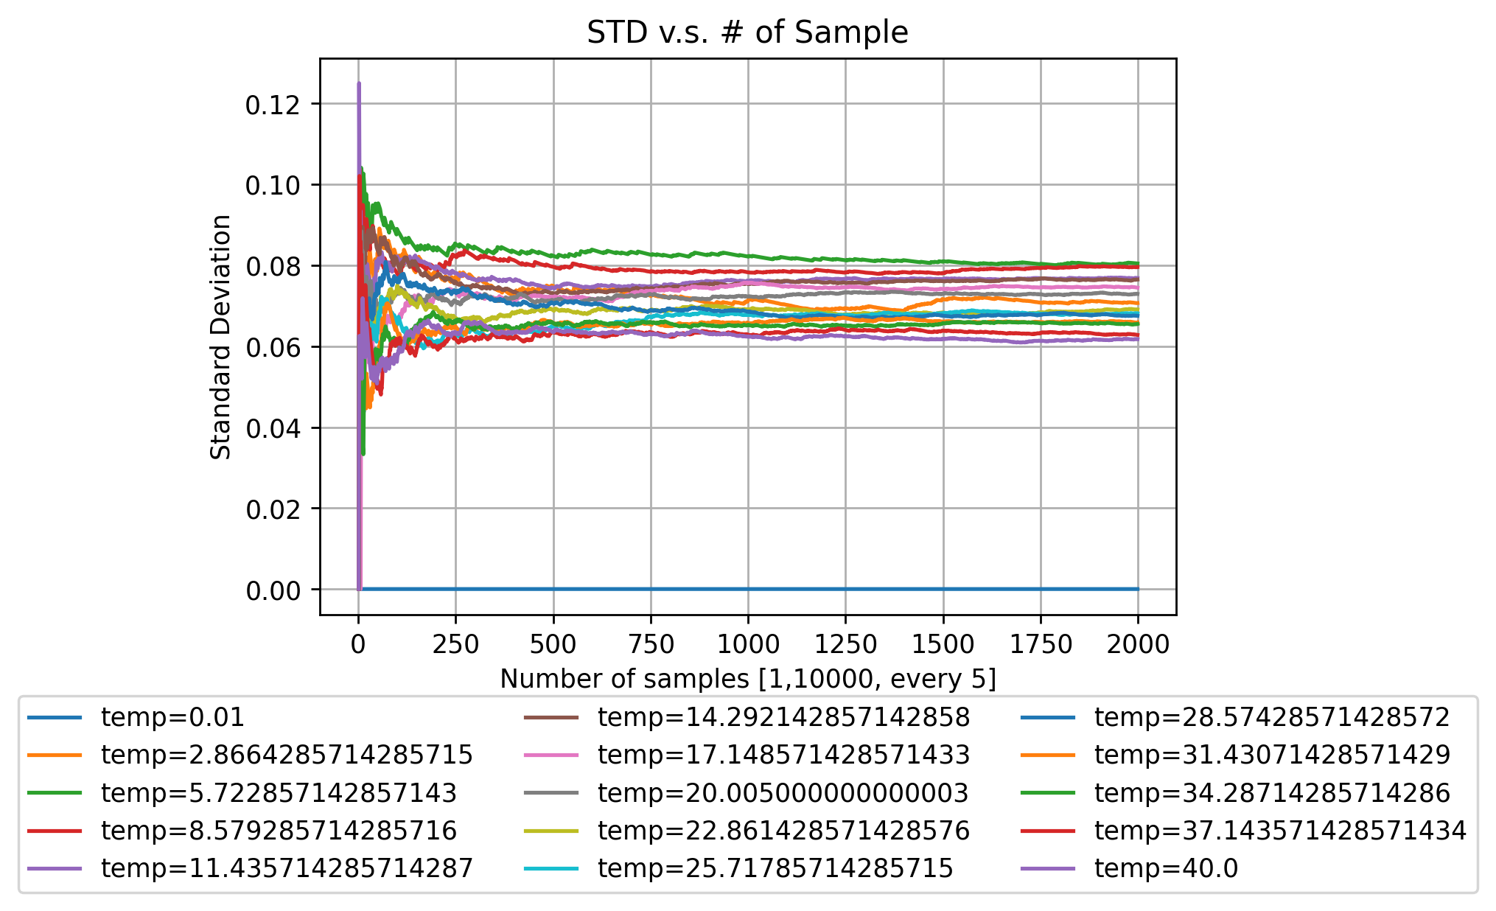
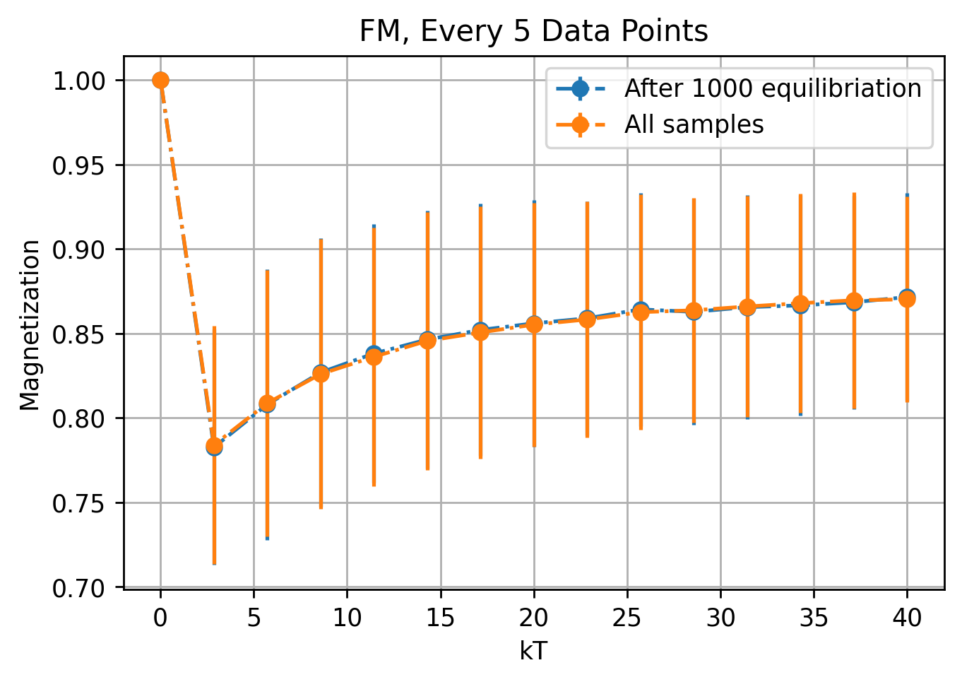
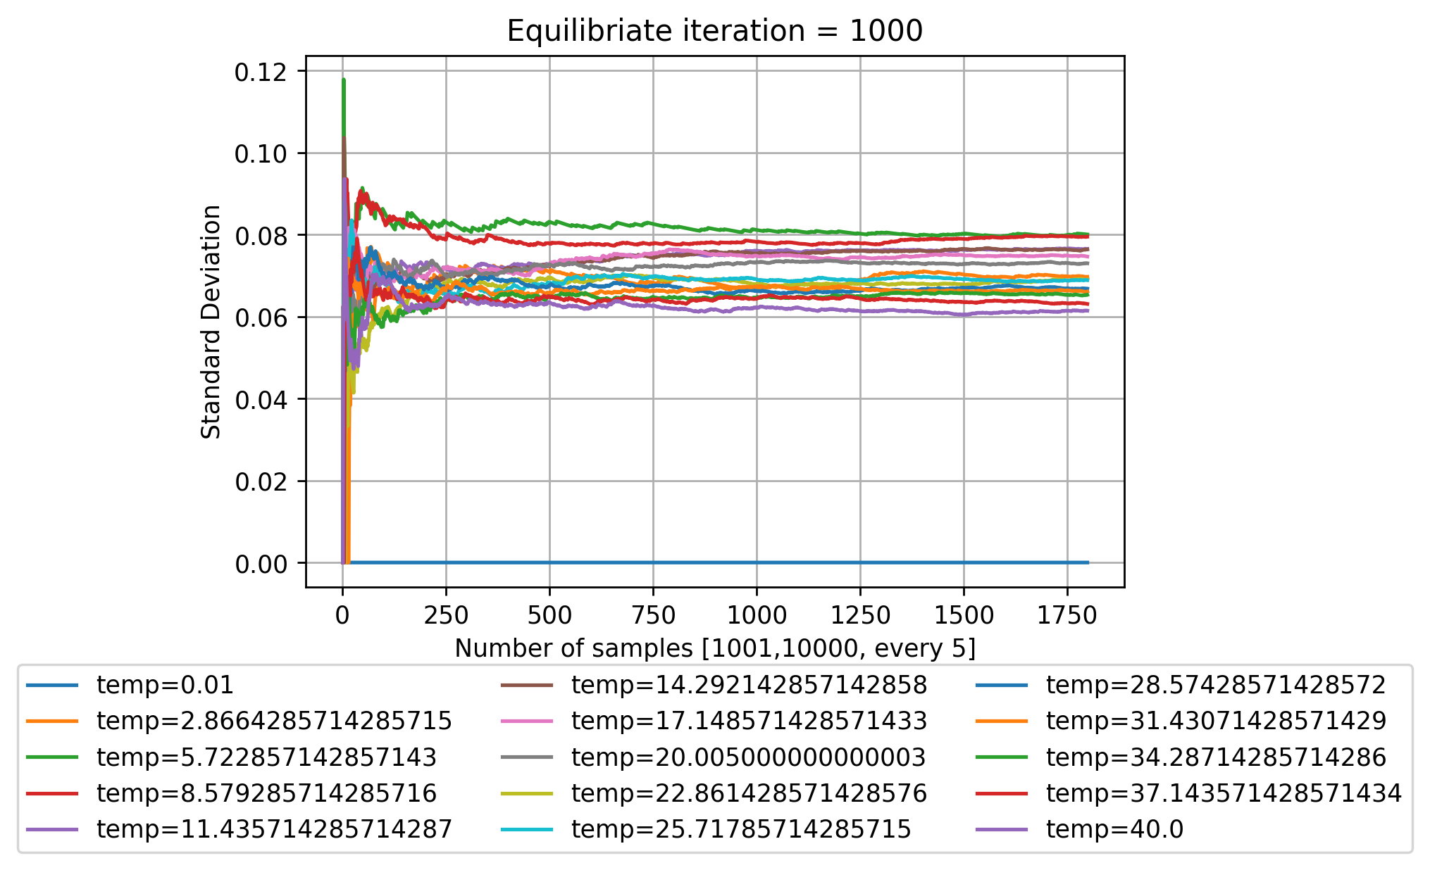
Aer_simulator: FM starting point (Relax for 5 iter’s)

Slide 9
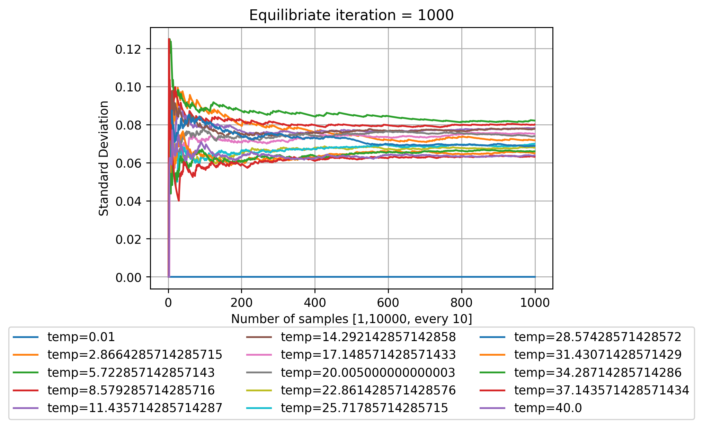

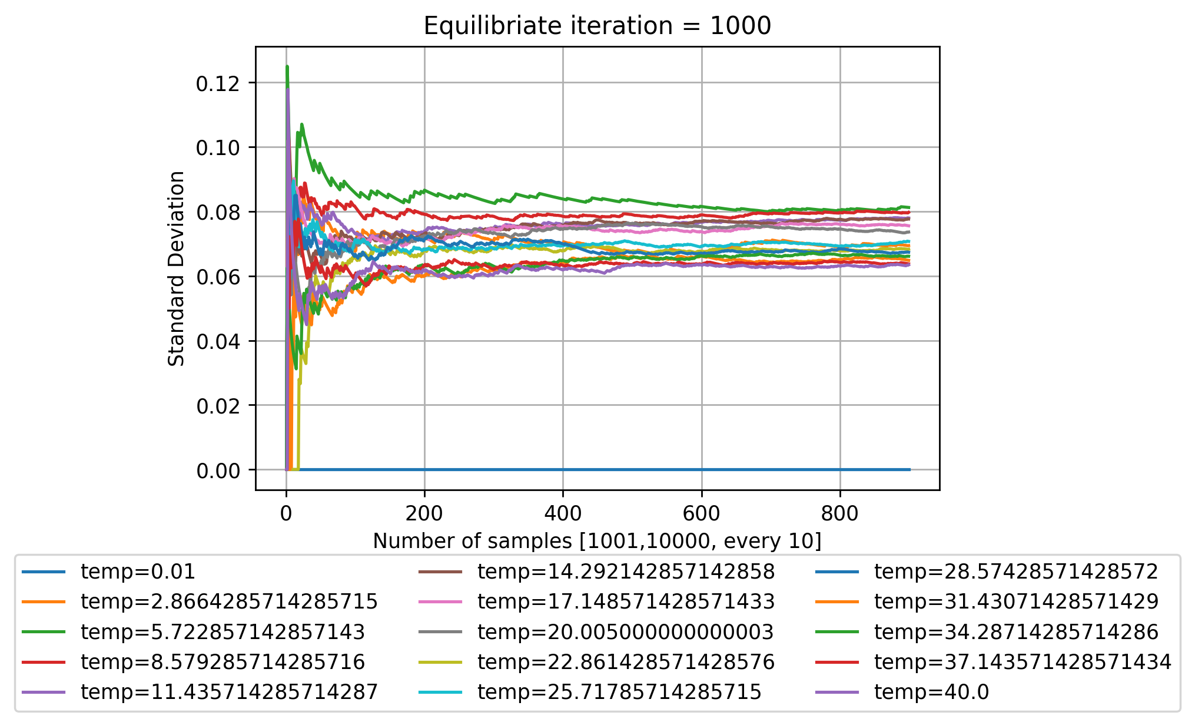
Aer_simulator: FM starting point (Relax for 10 iter’s)

Slide 10
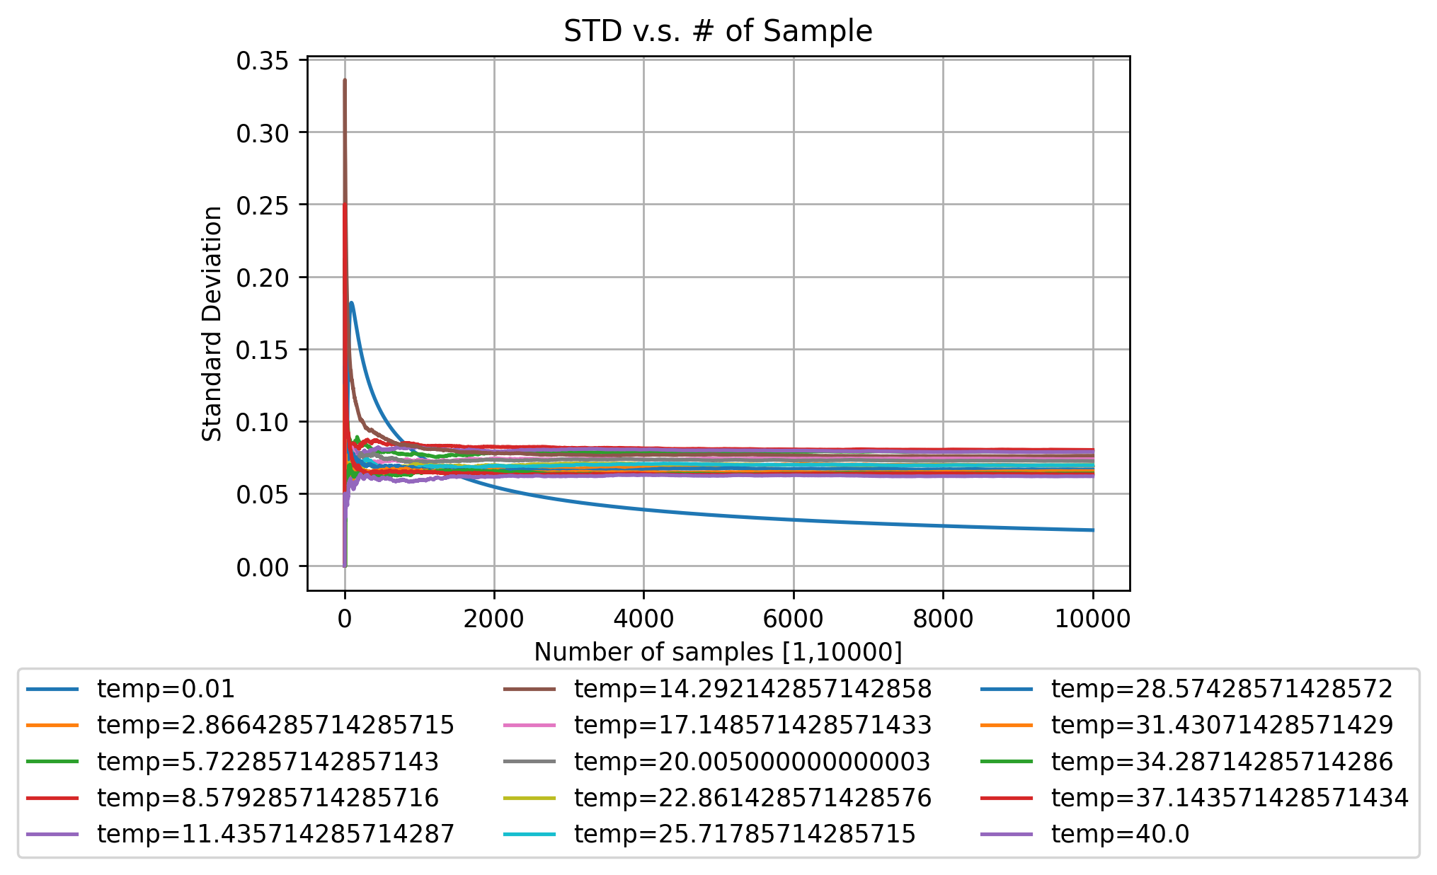
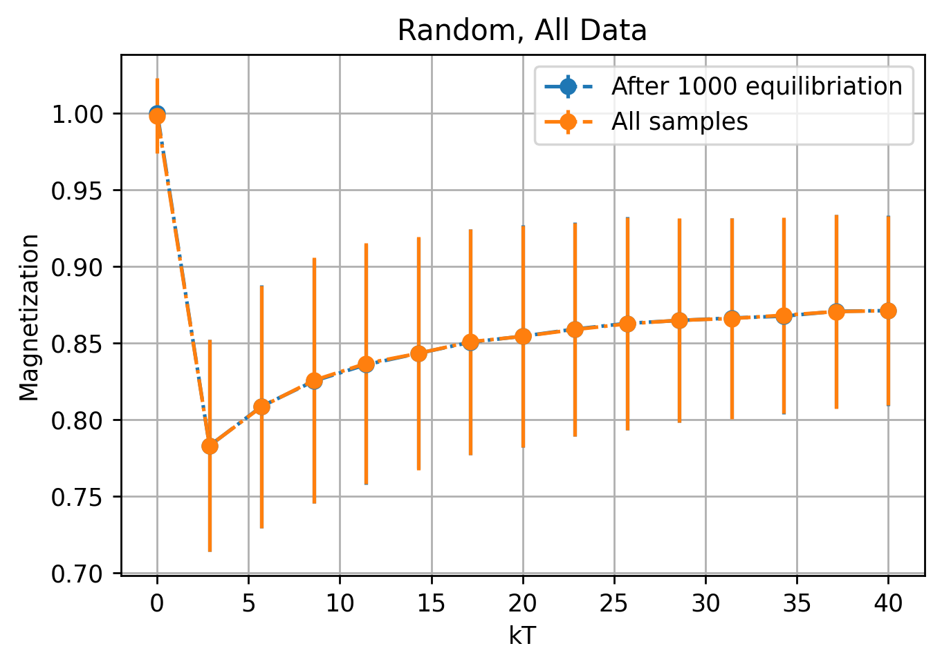
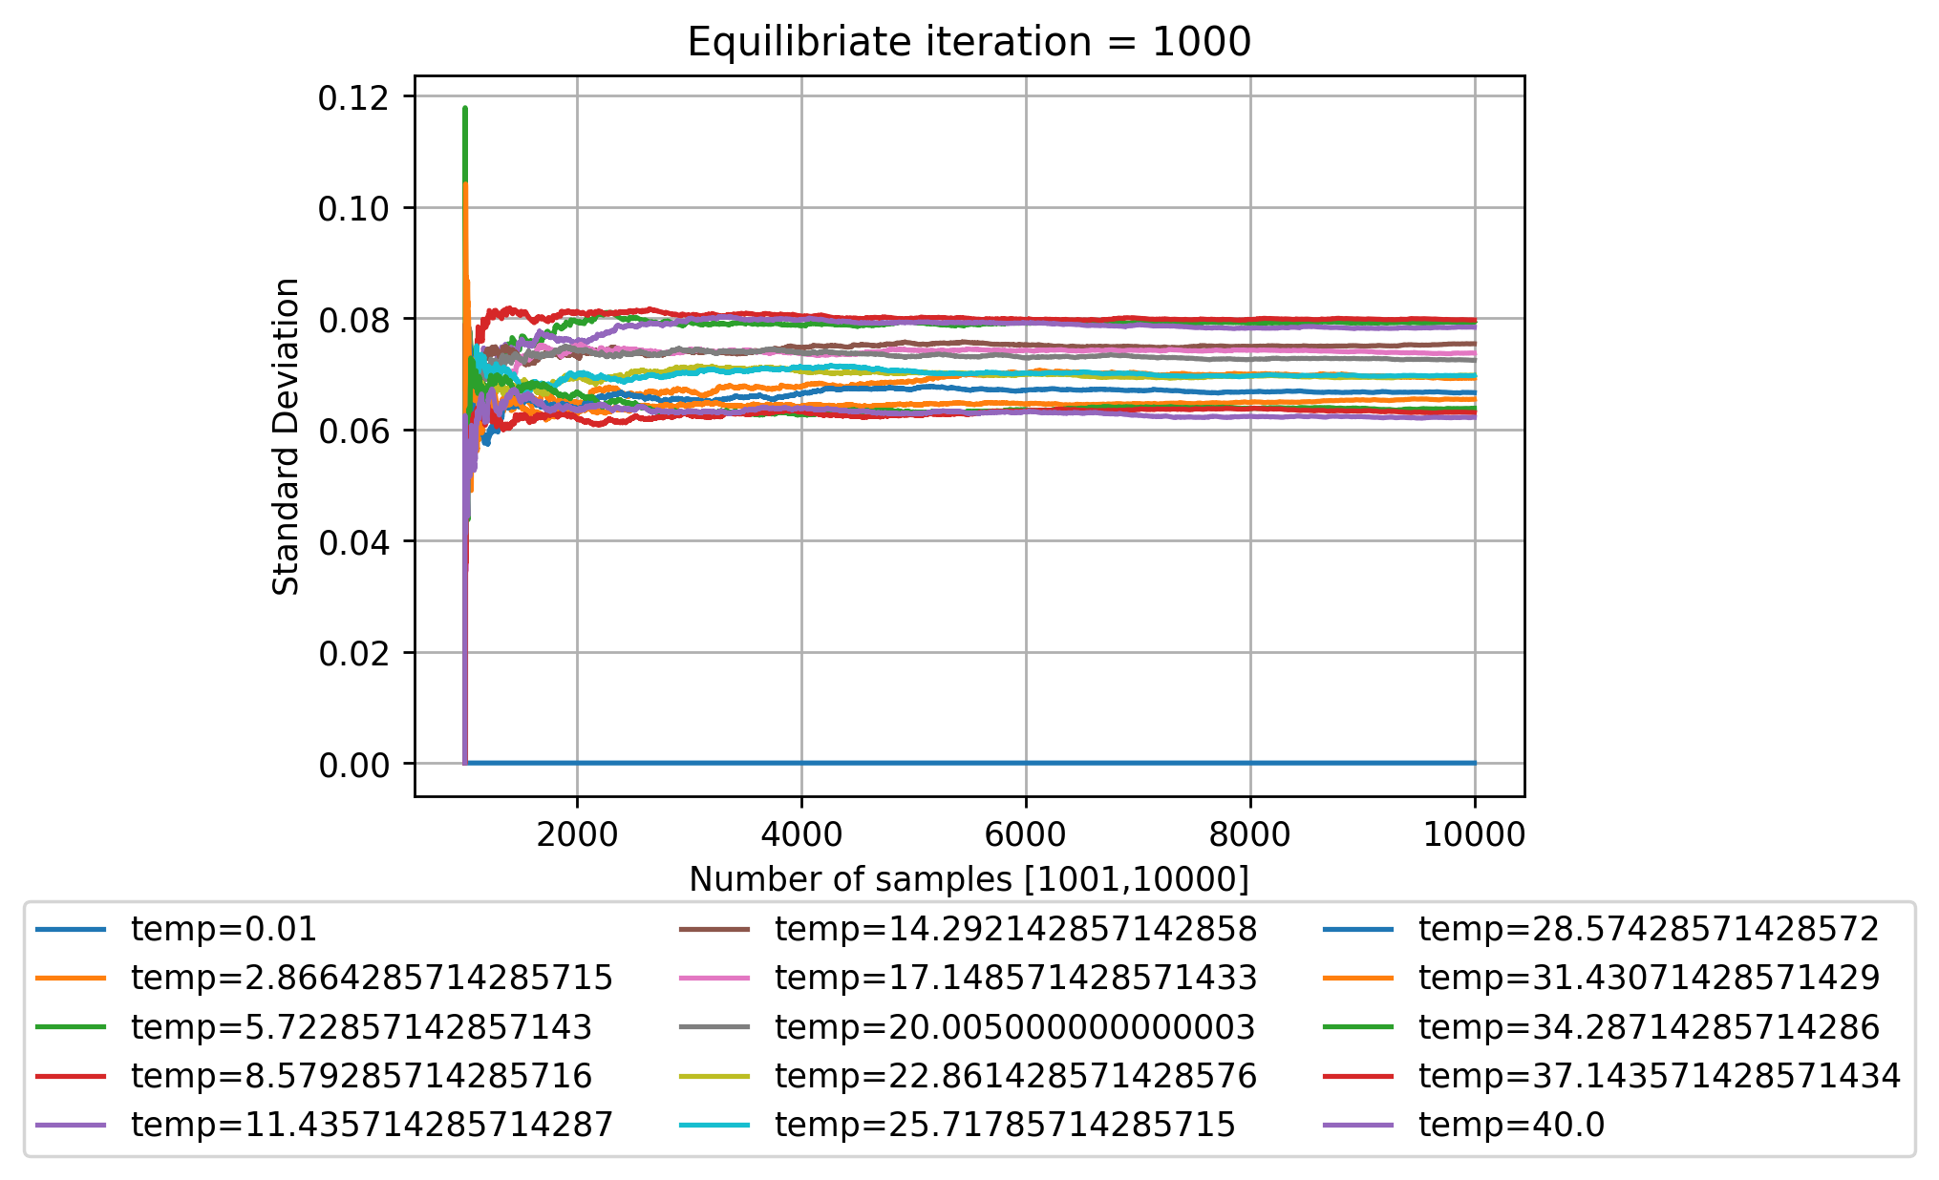
Aer_simulator: Random starting point

Slide 11
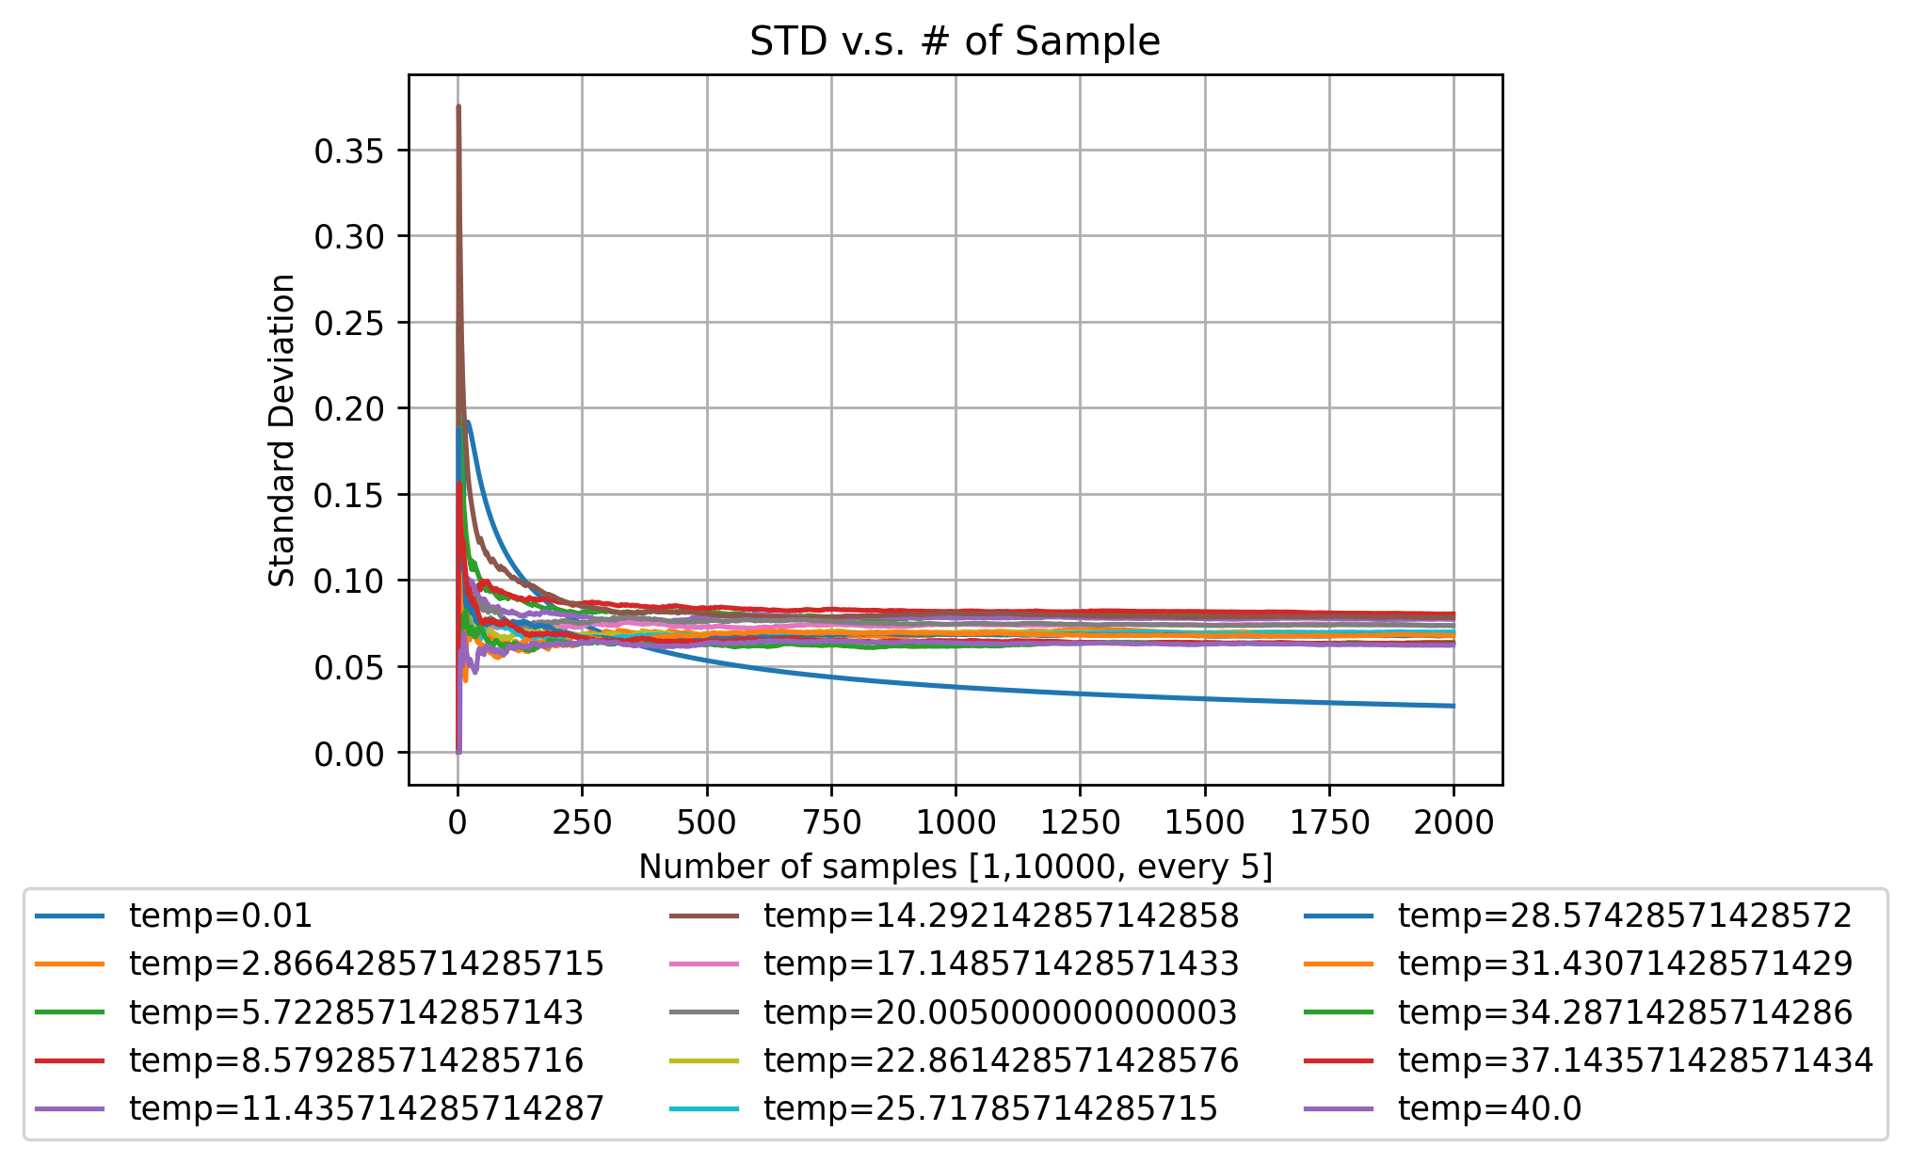

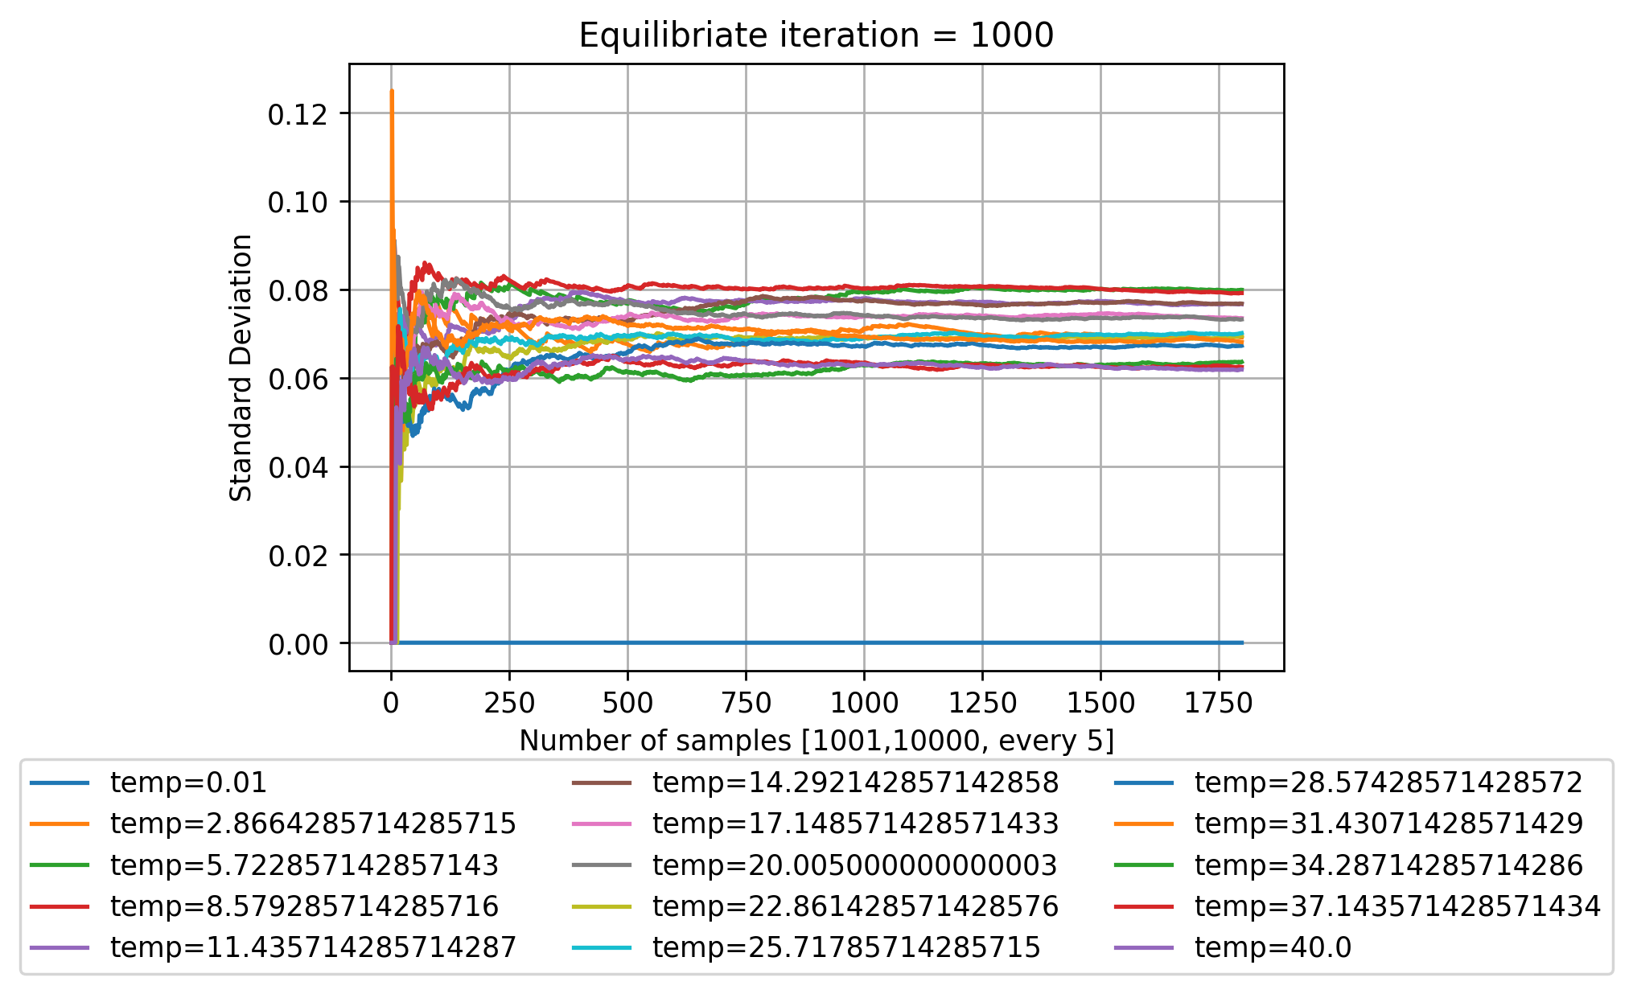
Aer_simulator: Random starting point (Relax for 5 iter’s)

Slide 12
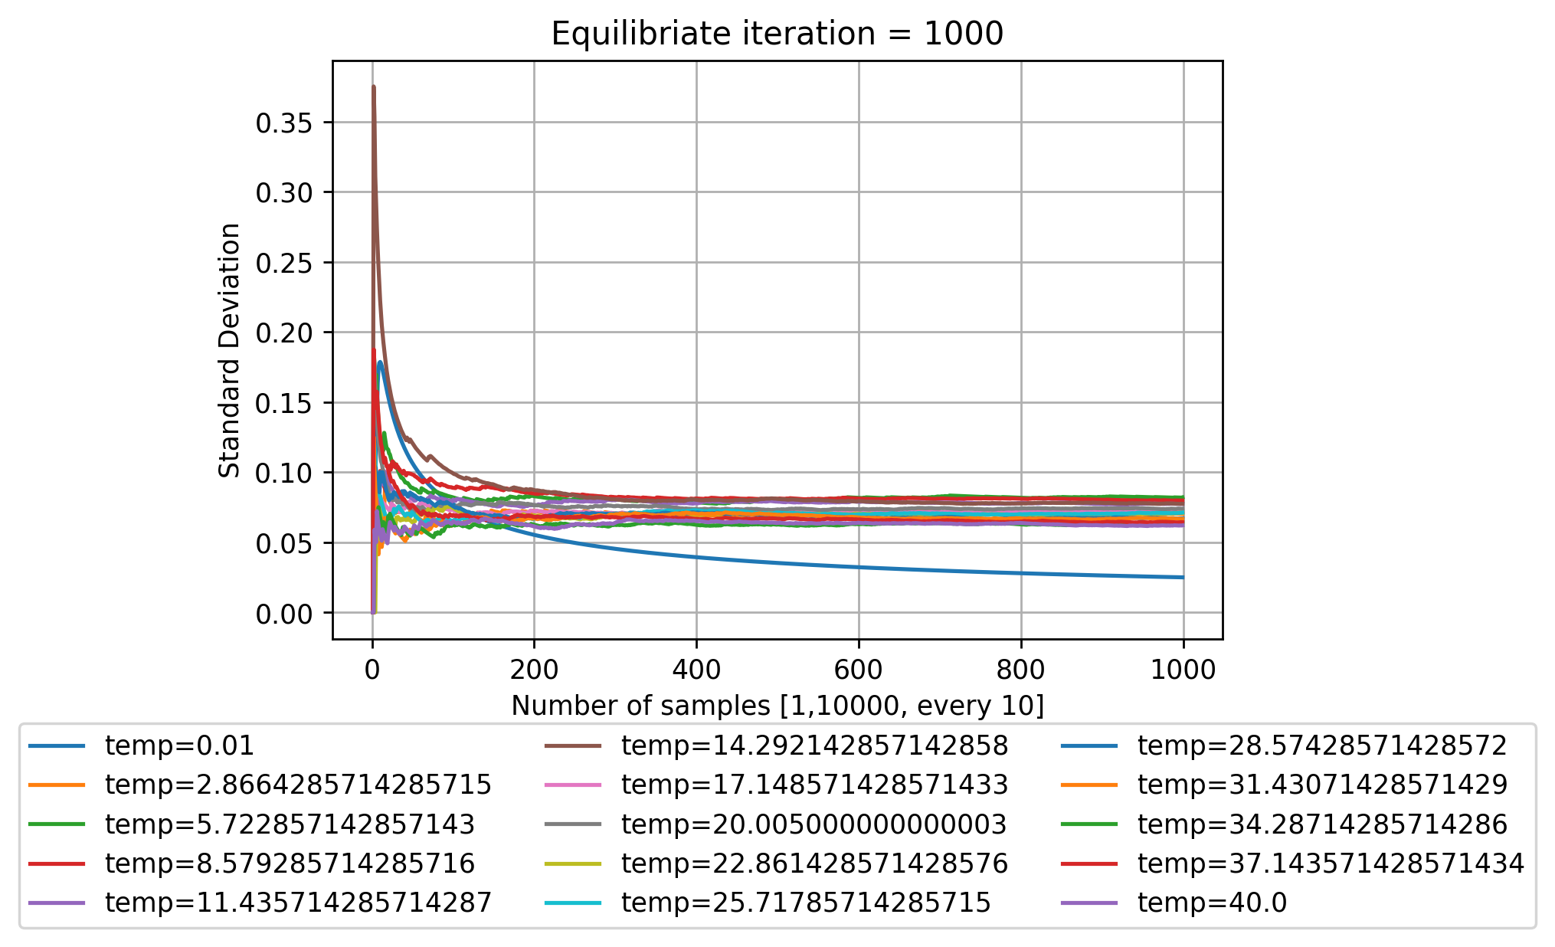

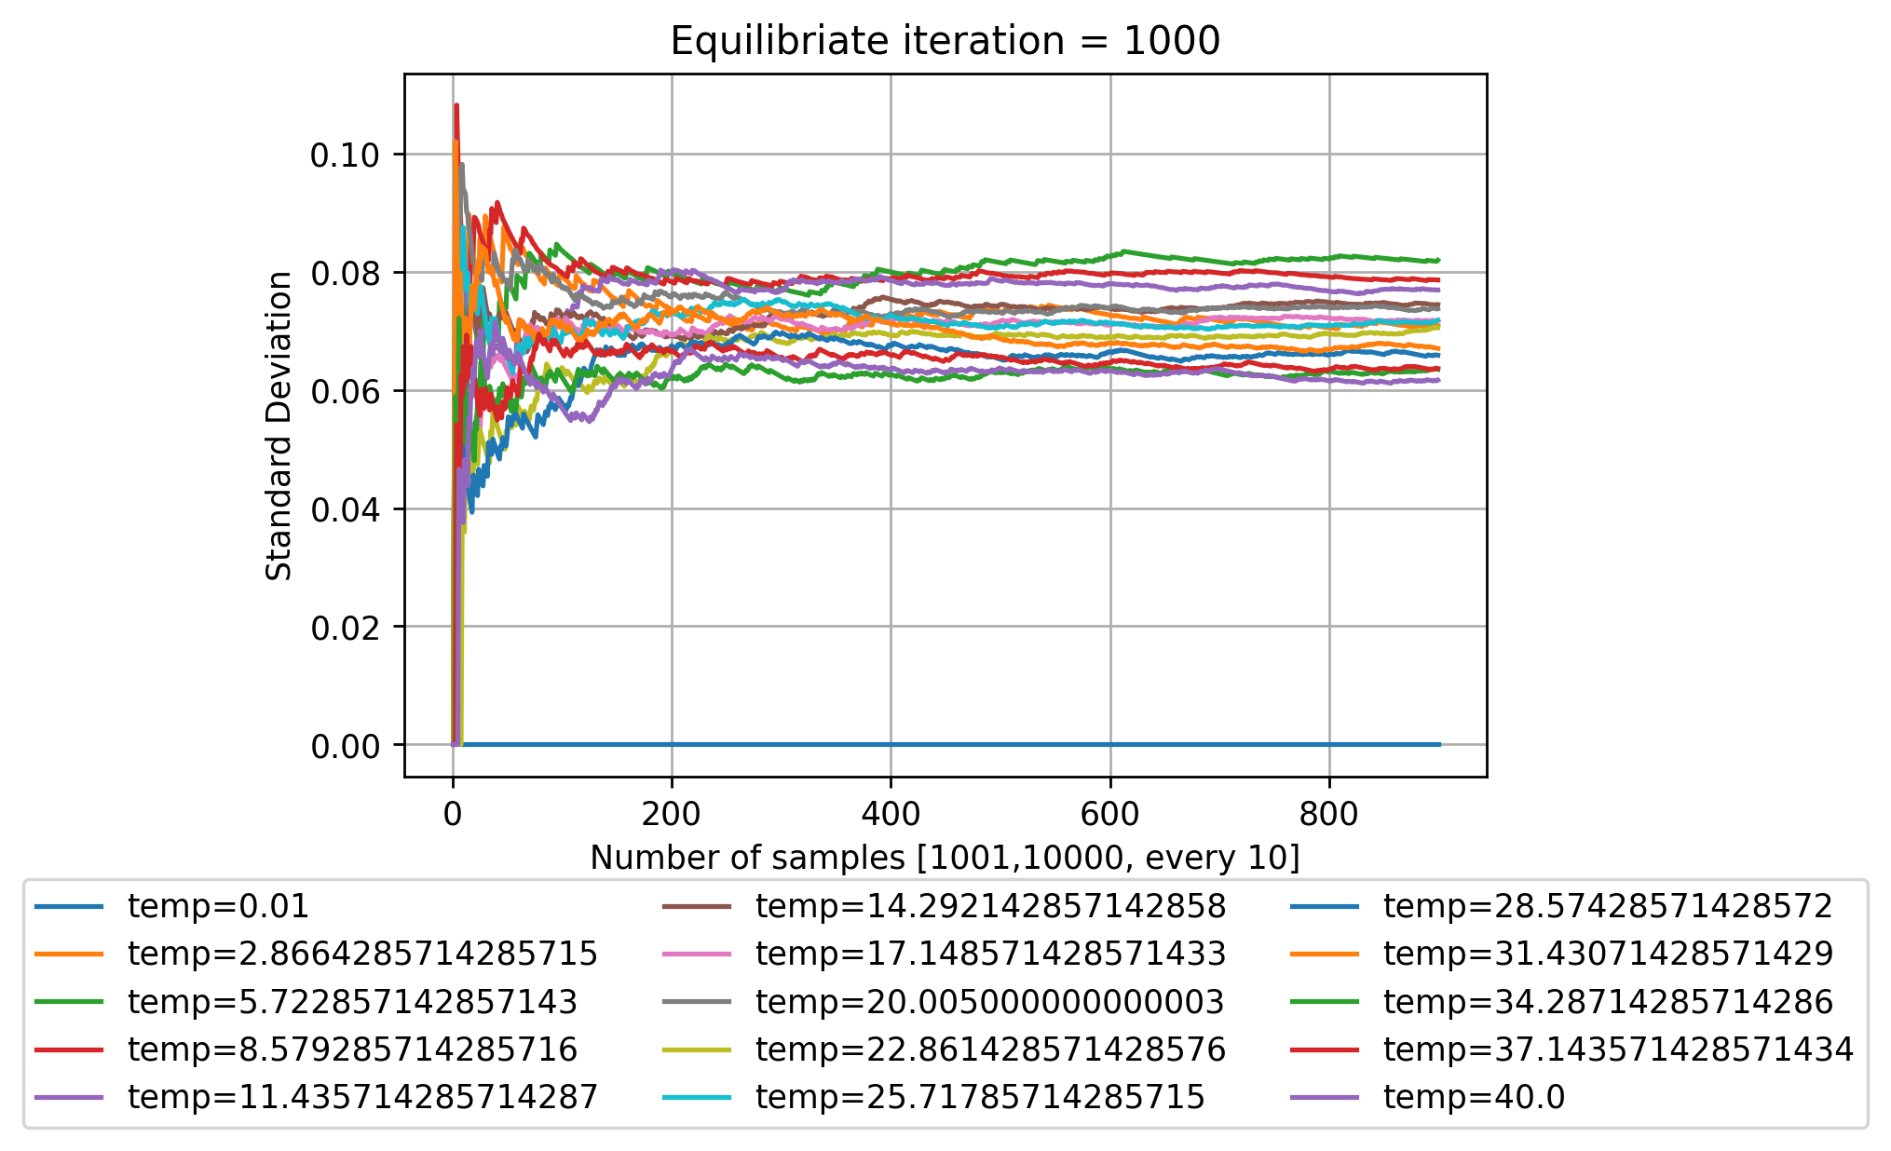
Aer_simulator: Random starting point (Relax for 10 iter’s)

